Slide 1

Lesson 3 (Part 2) Creating a ROS package containing publisher and subscriber nodes
AI for Mobile Robots - CSIP5202:
Intelligent Mobile Robotics (IMR)
Dr. Aboozar Taherkhani (PhD)
email: aboozar.taherkhani@dmu.ac.uk Surgery Hours: by appointment

Slide 2
Recap
Four primary components of ROS
Nodes: the universal name for the individual components or modules that need to send or receive information
Messages: the object for holding information that needs communicated between nodes
Topics: the virtual “chat rooms" where messages are shared
Master: the “conductor" that organizes the nodes and topics
ROS packages
The ROS software is divided into packages that can contain various types of programs, images, data, and even tutorials
Debugging
rostopic monitors ROS topics in the command line, rospy.loginfo() , and …

Slide 3
Overview
Create a ROS package
Create a simple publisher node using python
Create a subscriber node
Compile the created ROS package

Slide 4
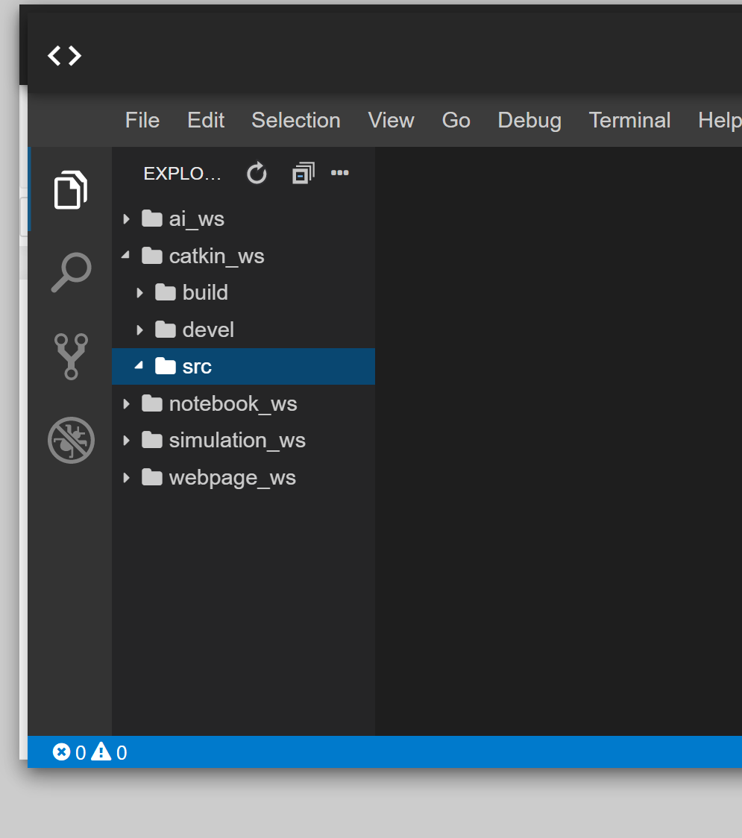
Create a ROS package
Catkin work space,‘catkin_ws’folder, contain a number of folders
Open a web shell and go to ‘catkin_ws/src’ folder by following command:
$cd catkin_ws/src/
Notes:
First in the ‘code Editor’ check the folders that you have. Find the ‘catkin_ws’folder, catkin work space.
Which folders are in ‘catkin_ws’?
Open a web shell and go to ‘catkin_ws/src’ folder by following command:
$cd catkin_ws/src/
When you are in the ‘src’ folder run the following command to create a new ROS package called ‘my_pakage’:
$catkin_creat_pkg my_pakage rospy
This will create a package that’s depend on rospy. rospy is a python module for ROS.
what changes did happen in side ‘catkin_ws/src ‘ folder?

Slide 5
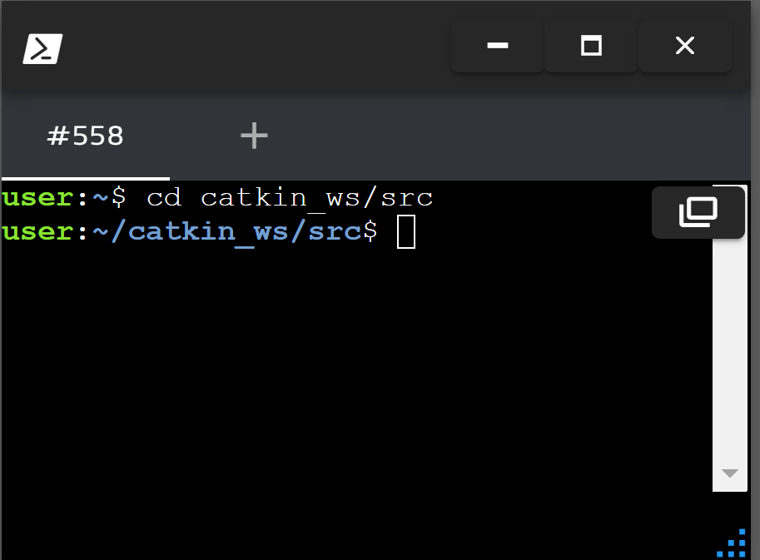
Create a ROS package
Open a web shell and go to ‘catkin_ws/src’ folder by following command:
$cd catkin_ws/src/
When you are in the ‘src’ folder run the following command to create a new ROS package called ‘my_package’:
$catkin_create_pkg my_package rospy
This will create a package that’s depend on rospy.
rospy is a python module for ROS.
what changes did happen in side ‘catkin_ws/src ‘ folder?
Notes:
First in the ‘code Editor’ check the folders that you have. Find the ‘catkin_ws’folder, catkin work space.
Which folders are in ‘catkin_ws’?
Open a web shell and go to ‘catkin_ws/src’ folder by following command:
$cd catkin_ws/src/
When you are in the ‘src’ folder run the following command to create a new ROS package called ‘my_pakage’:
$catkin_creat_pkg my_pakage rospy
This will create a package that’s depend on rospy. rospy is a python module for ROS.
what changes did happen in side ‘catkin_ws/src ‘ folder?

Slide 6
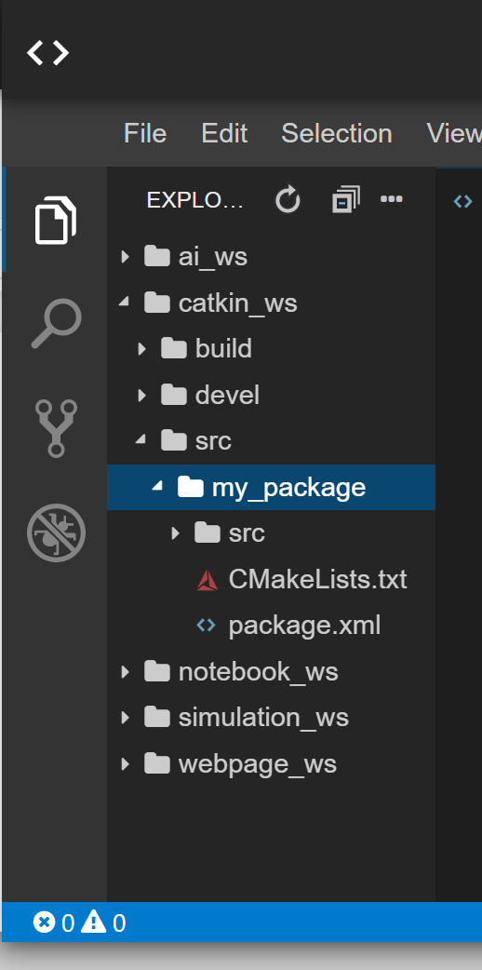
Create a ROS package
what changes did happen in side ‘catkin_ws/src ‘ folder?
Notes:
First in the ‘code Editor’ check the folders that you have. Find the ‘catkin_ws’folder, catkin work space.
Which folders are in ‘catkin_ws’?
Open a web shell and go to ‘catkin_ws/src’ folder by following command:
$cd catkin_ws/src/
When you are in the ‘src’ folder run the following command to create a new ROS package called ‘my_pakage’:
$catkin_creat_pkg my_pakage rospy
This will create a package that’s depend on rospy. rospy is a python module for ROS.
what changes did happen in side ‘catkin_ws/src ‘ folder?

Slide 7
Write a python code to create a publisher node
Right click on the ‘src’ folder in the package folder that you want to put your publisher node, i.e. ‘my_package/src’, and create a new file. Call it talker.py
Get the python code for a simple publisher here: talker.py

Slide 8
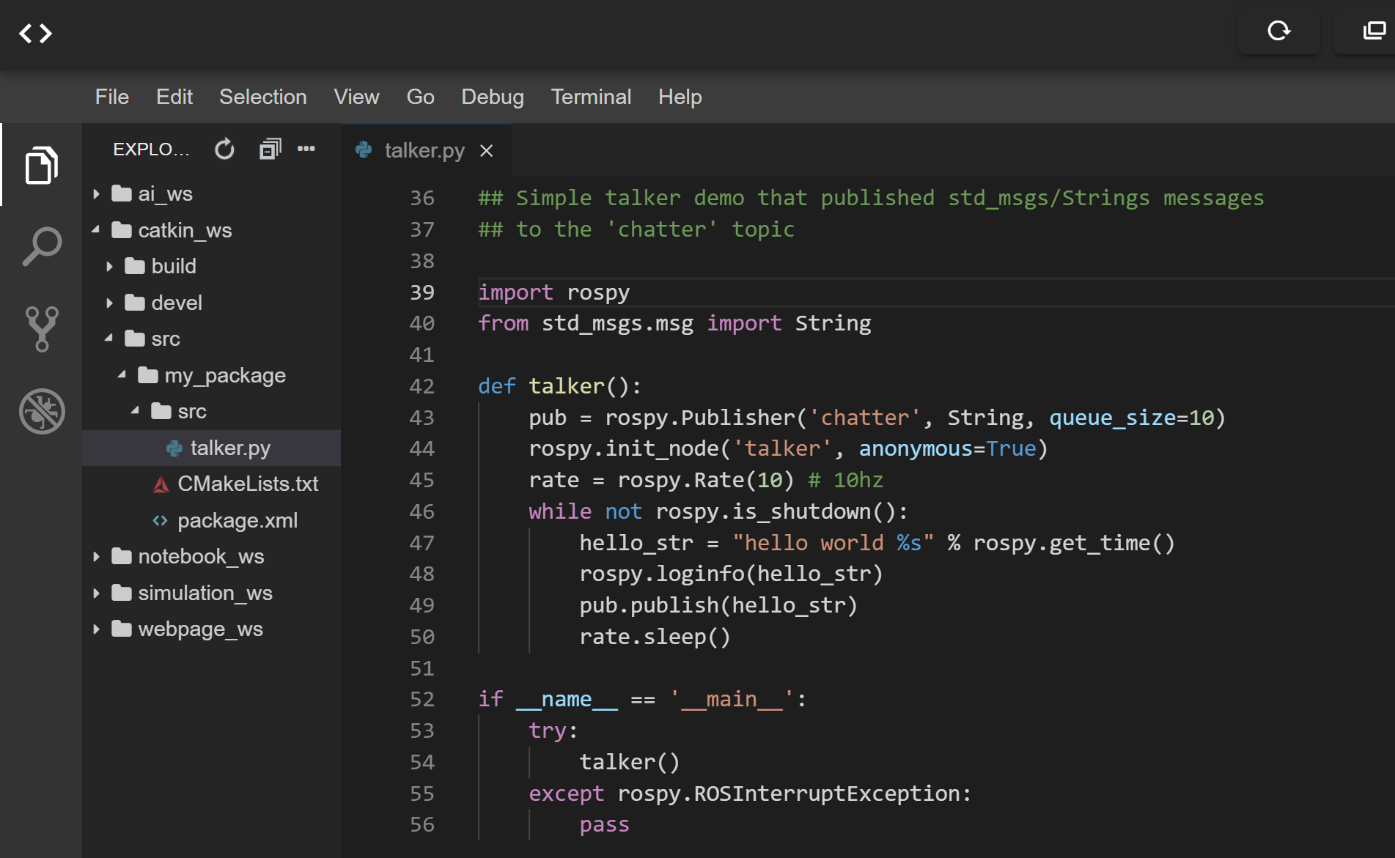
Write a python code to create a publisher node

Slide 9
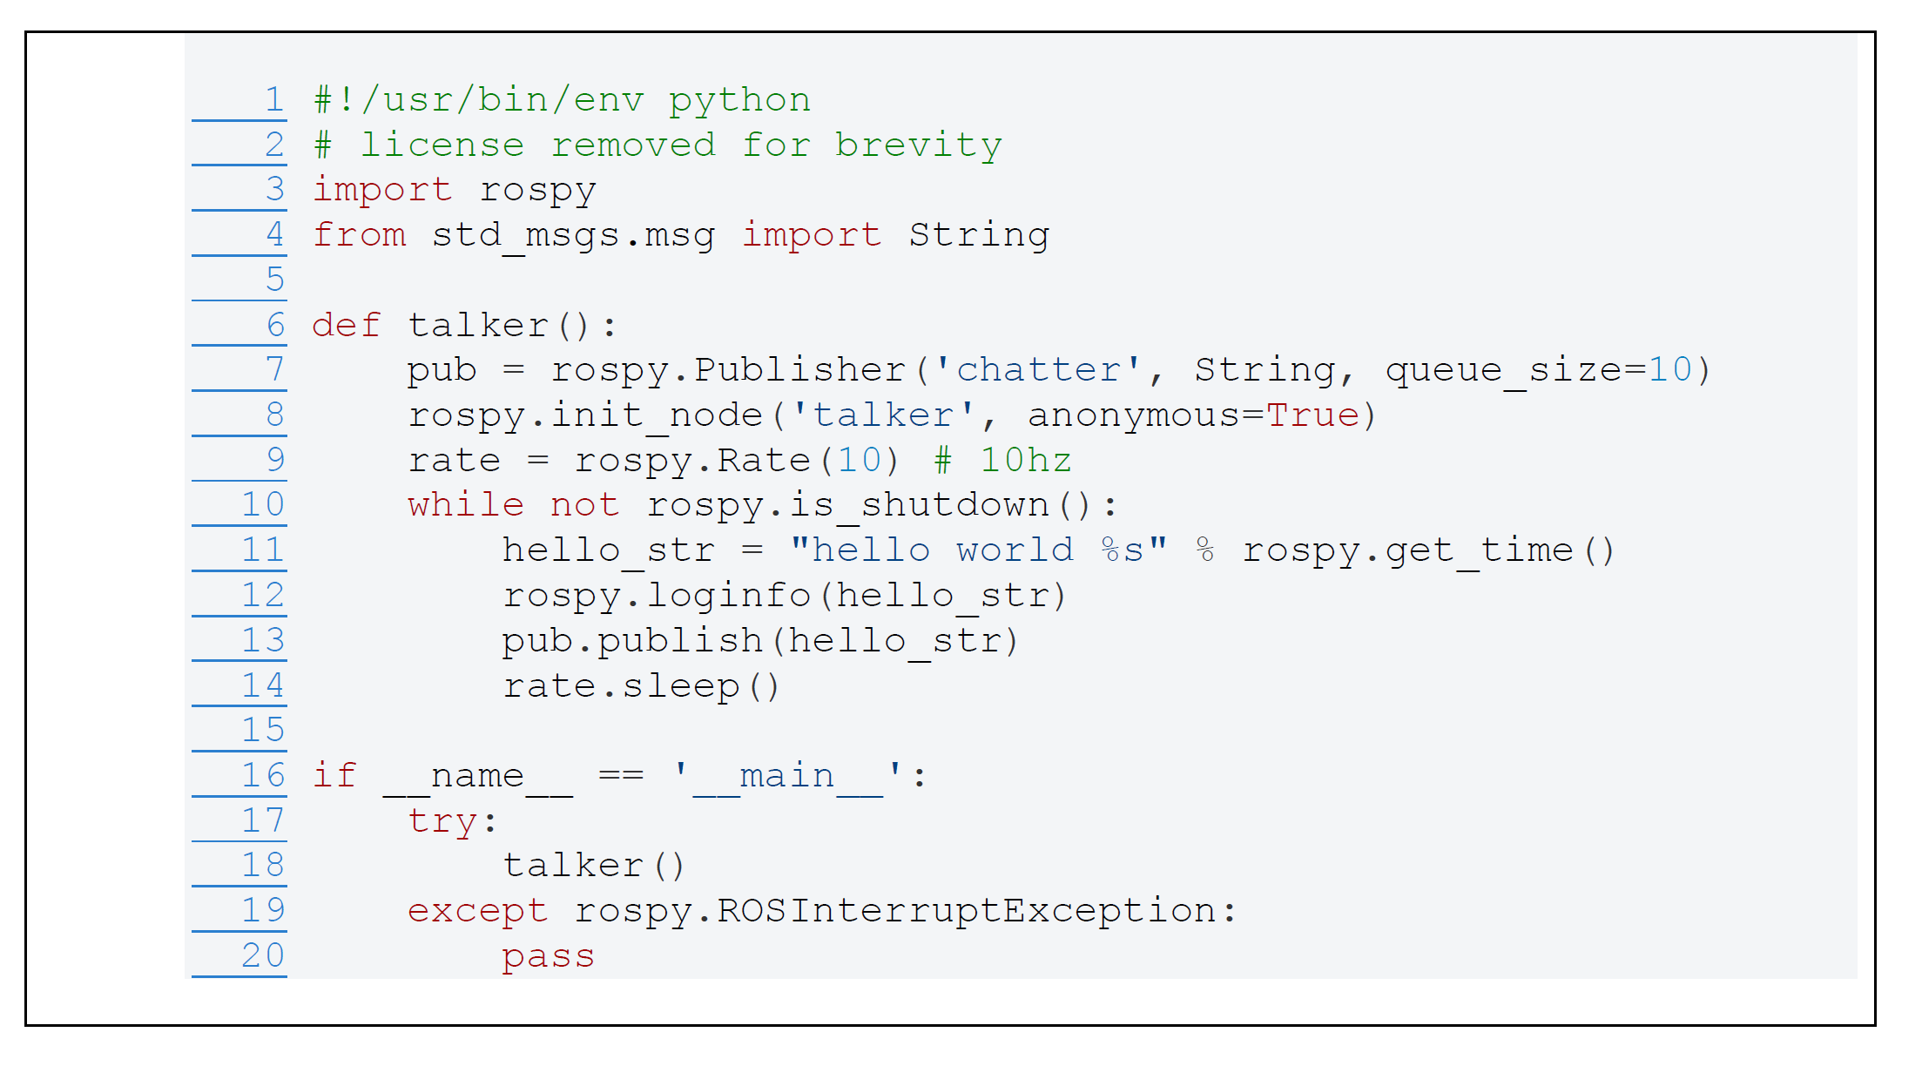
Write a python code to create a publisher node
pub = rospy.Publisher("chatter", String, queue_size=10)
declares that we have a ‘chatter’ topic that the node can publish messages with the type of String. (String is the class std_msgs.msg.String).
rospy.init_node(NAME, ...)
tells rospy the name of the node
In rospy.init_node('talker', anonymous=True)the node’s name is talker
[1] Writing a Simple Publisher and Subscriber (Python)
http://wiki.ros.org/ROS/Tutorials/WritingPublisherSubscriber%28python%29

Slide 10
Write a python code to create a publisher node
anonymous=True: Ensures the node has a unique name by appending random characters to talker (useful when running multiple instances)
rospy.loginfo(hello_str): Logs the message to the ROS console.

Slide 11
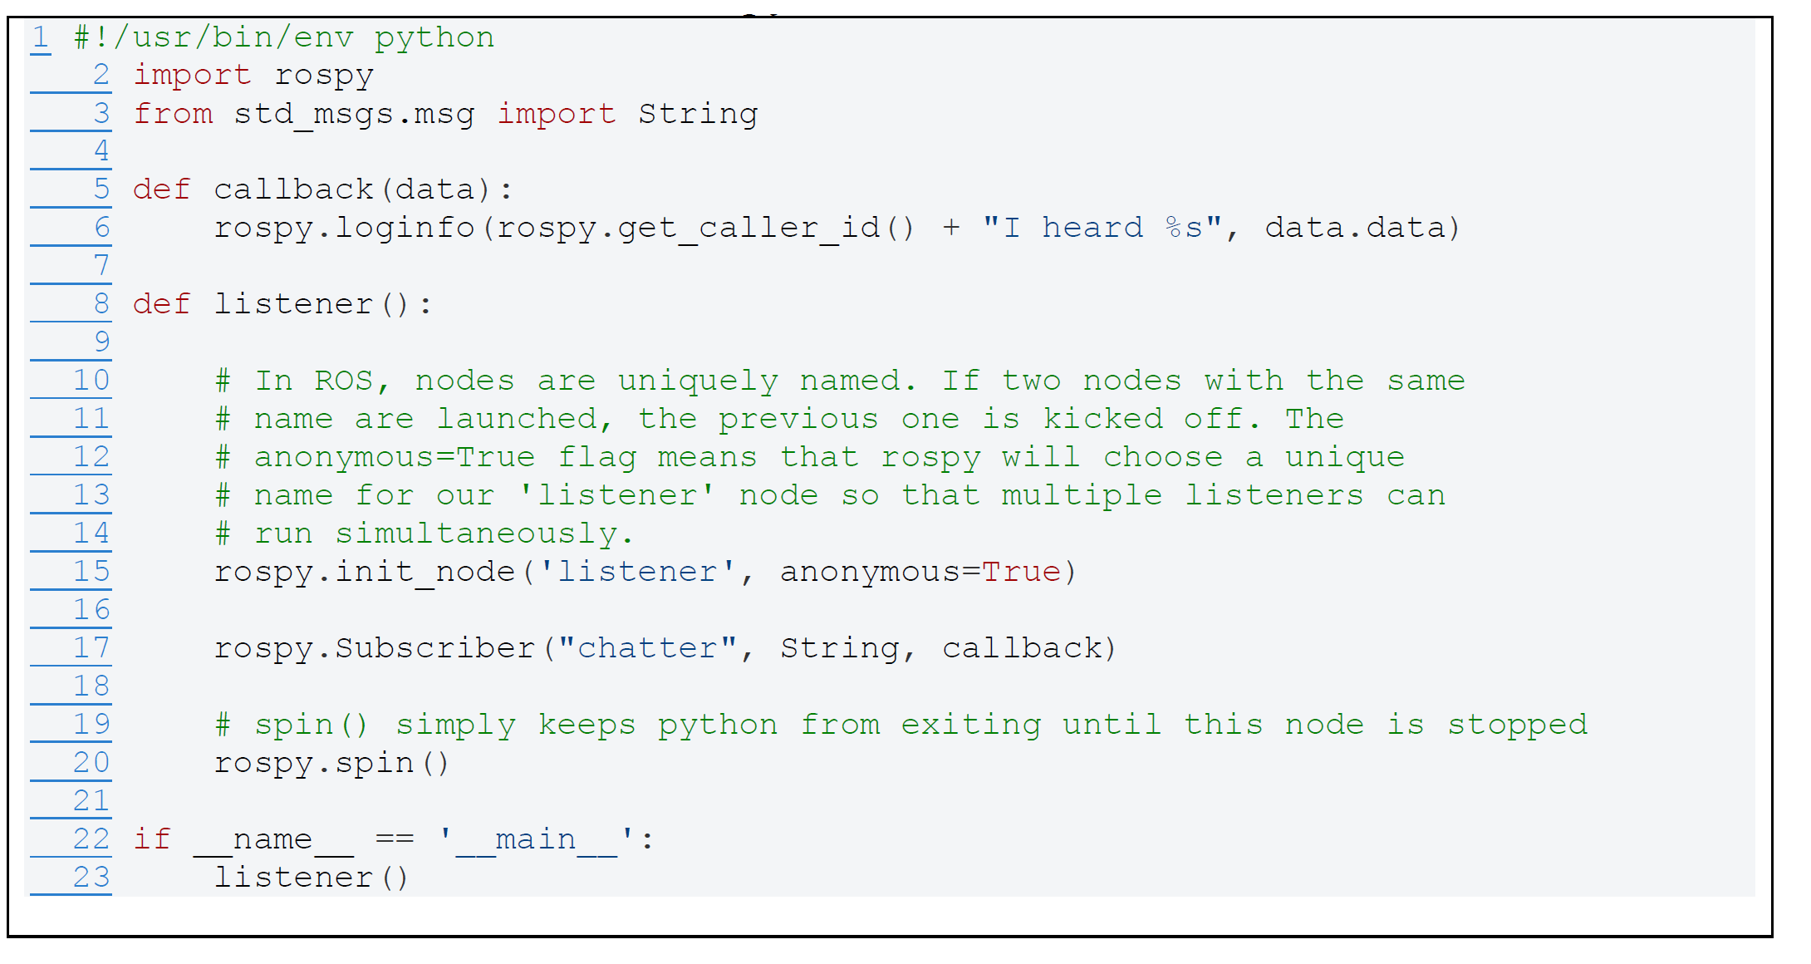
Write a python code for subscriber node
listener.py

Slide 12
Compile the package (Building publisher and subscriber nodes)
As we have newly added two python codes to the package, i.e. my_package, we need to compile ROS package using catkin as a build system
To compile the package go to catkin work space, i.e. ‘catkin_ws’ folder, in a web shell by running the following commands:
$ cd /catkin_ws
$ catkin_make
Run ROS master using ‘$roscore’ command
Start both nodes with following comments:
$ python talker.py
$ python listener.py.

Slide 13
Summary
Create a ROS package
$catkin_create_pkg
Write a python code to create a publisher node
Write a python code for subscriber node
Compile the package (Building publisher and subscriber nodes)
$ cd /catkin_ws
$ catkin_make

Slide 14
Reference
[1] Writing a Simple Publisher and Subscriber (Python)
http://wiki.ros.org/ROS/Tutorials/WritingPublisherSubscriber%28python%29
[2] Creating a ROS Package
http://wiki.ros.org/ROS/Tutorials/CreatingPackage
[3] ROS Robotics By Example
By Carol Fairchild, Dr. Thomas L. Harman
The pdf of the book is available on DMU library::
https://dmu.summon.serialssolutions.com/?s.q=ROS+Robotics+By+Example&s.cmd=#!/search?ho=t&l=en-UK&q=ROS%20by%20example

